Slide 1
Lesson 18 – Homework review

Slide 2
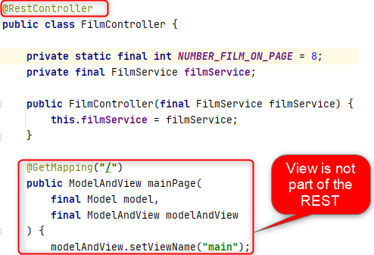
REST vs MVC

Slide 3
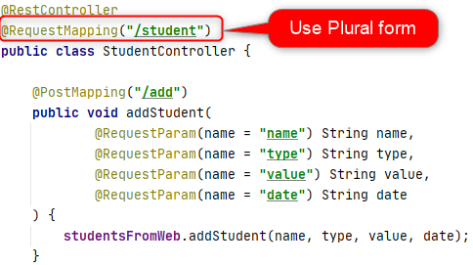
Follow naming convention

Slide 4
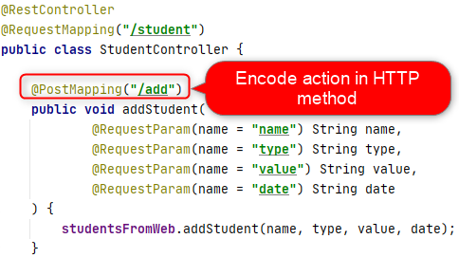
Encode intent in HTTP method

Slide 5
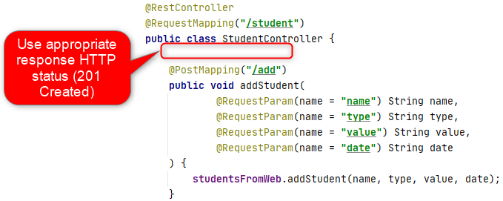
Return correct response status

Slide 6
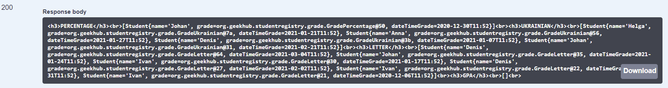
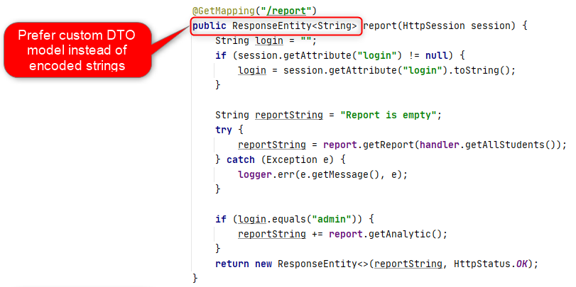
Use response model

Slide 7
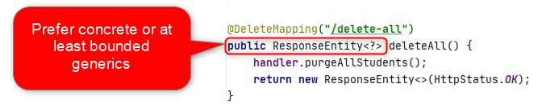
Be more concrete

Slide 8
Thanks!
Any Questions?
Or find us in Slack:
@Yaroslav Brahinets
@Vasya Rudas

